Slide 1


Slide 2
Team : Byte Brigade
Ameerroshan
SRINIVAS GUPTA
Yuvarajasimha Reddy Chitta
Shaik Basheer

Slide 3
Time Management and Productivity
It is designed to help students manage their time effectively, prioritize tasks, and maintain a healthy work-life balance
These tools can analyze students' schedules, study habits, and productivity patterns to provide personalized recommendations for optimizing their time usage and increasing their productivity.

Slide 4
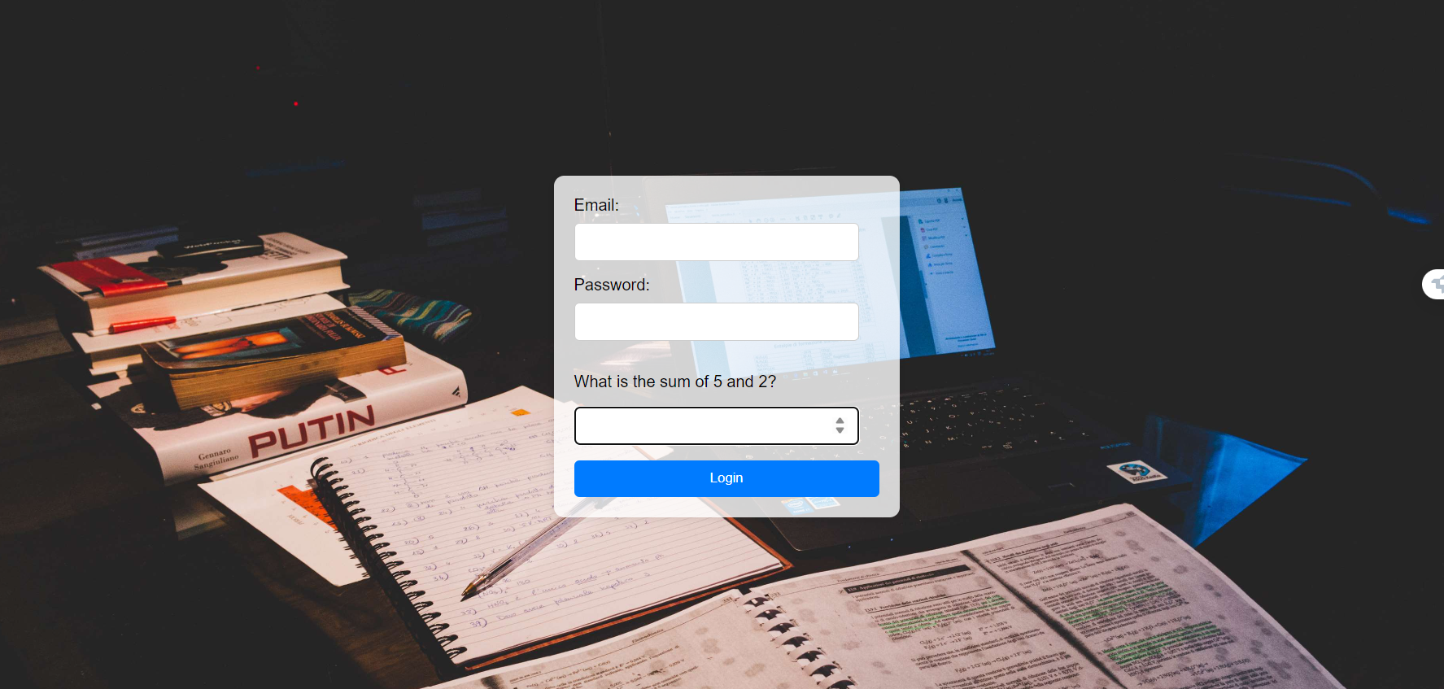
Website Images

Slide 5
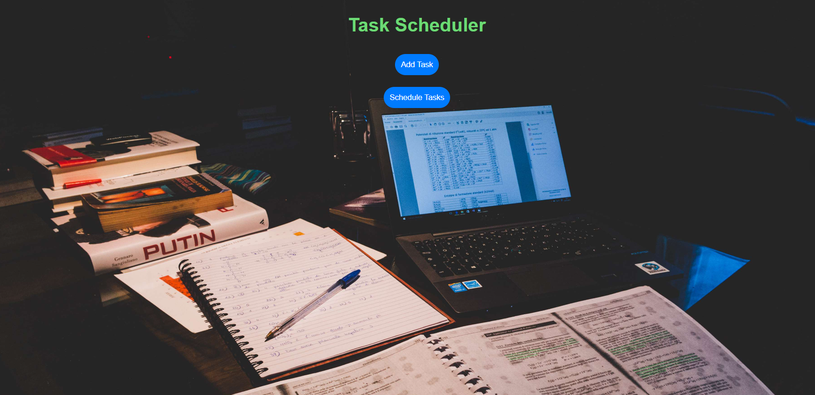
Website Images

Slide 6
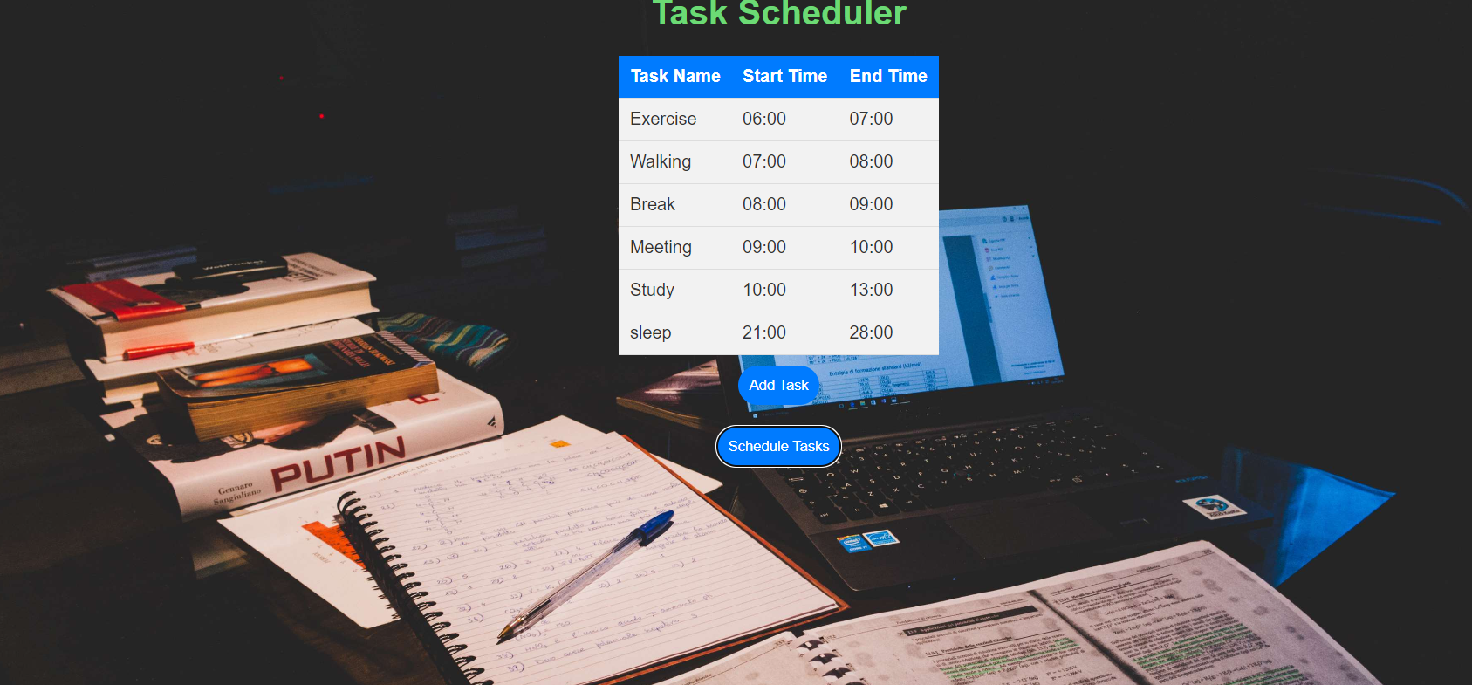
Website Images

